Slide 1
Improving Practice Presentation
By Jane Black, Designated Nurse Safeguarding Children

Slide 2
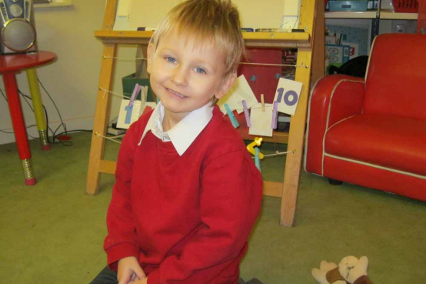
Daniel Pelka - born 15th July 2007, died 3rd March 2012, age 4
http://www.coventrylscb.org.uk/dpelka.html
Daniel was four years and eight months old at the time of his death. He was the middle child of a family who had migrated to the UK in 2005 from Poland. He was killed by his mother and stepfather following a long period of physical abuse and neglect. Daniel’s mother and stepfather had an abusive relationship which was known to professionals from key agencies.
Learning
Importance of:
• Considering domestic abuse as part of the risk assessment for all children
• A multi-agency approach when assessing the
significance of bruising and other injuries and the risk
of future harm.

Slide 3
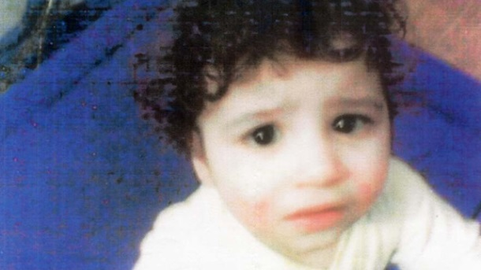
Hamzah khan – died 2009, age 4
http://www.bradford-scb.org.uk/hamzah_khan_scr.htm
Hamzah was a four year old boy of Asian and British descent believed to have died in 2009. His body was discovered in 2011. The cause of death is unknown; he was possibly starved to death. Mother had known issues of alcohol misuse and there were reports of domestic violence.
Learning
• Significance of missed health
appointments
• Importance of robust assessments that take into account multiagency views, history of injuries, assessment of domestic violence

Slide 4
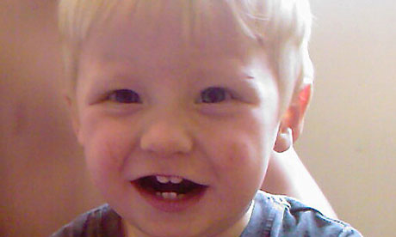
Keanu Williams – died January 2011, age 3
http://www.lscbbirmingham.org.uk/index.php/serious-case-review/published-serious-case-reviews
Keanu was a three year old boy of British descent who died following multiple injuries. His mother, a care leaver, had had previous children removed for neglect and physical abuse. There had been a history of domestic violence between mother and her partner.
Learning
Importance of:
• Assessment of children’s needs
• Professional compliance with policies and procedures
• Information sharing and collaborative working

Slide 5
Riley Pettipierre – died March 2012, age 2
http://www.derbyshirescb.org.uk/
Riley was a two year old boy of British descent who died in March 2012. His mother was a known Methadone and illicit drug user and Riley died following ingestion of Methadone.
Learning
Importance of:
• The need for shared care with GPs to manage substance misusers
• Responsibilities of Health services to assess parenting capacity of substance misusers
• Assessments from all health workers (GPs, midwifes, health visitors) considering the impact of substance misuse on parenting capacity.

Slide 6
Child K – Suffered serious injuries age 15 months
Child K was a young boy who suffered serious injuries when in care of his father and mother. His parents delayed taking him to hospital for treatment and on arrival he was close to death. Multi-agency records were reviewed in relation to this case. Information emerged about child K’s father including history of violence and cruelty to women and he was regarded as a risk to children. Child K’s older half-sister had made a disclosure at her school that mothers partner had sexually abused her. Disclosure resulted in no further action.
Learning
Importance of:
• Multi-agency responsibilities and understanding in dealing effectively with child sexual abuse
• Professional multi-agency challenge

Slide 7
Child J - Abused between 7 & 10 years of age
Child J was a girl who was sexually abused by her older brother on a number of occasions between the age of seven and ten. She made disclosures to her mother and Children’s Services on the first occasion however professionals within a number of agencies failed to protect her from subsequent abuse. This was a family of complex makeup, multiple partners and family well known to services including Children’s Services because of issues of neglect and physical assault by mother’s partners but also known domestic violence.
Learning
Importance of:
• All professionals having an understanding of indicators of sexual abuse
• Professional multi-agency challenge

Slide 8
Child E – Abused from birth to age 12
Child E came to notice of professionals when she became pregnant aged twelve, she came from a large family of siblings and step siblings. Long history of chronic neglect and intergenerational sexual abuse, many reported instances of sexualised behaviour by Child E and her siblings.
Learning
Importance of:
• Assessment of neglect
• Understanding of indicators of sexual abuse
• Professional challenge

Slide 9
Child F – Became a looked after child, age 9
Nine year old who had never attended school or received any suitable education. He had also suffered significant neglect whilst living in the family home.
Learning
• Awareness and prevention of Child becoming ‘lost’ to multi-agency network including school

Slide 10
Child I –Became a looked after child, age 3½
Subject of severe neglect while in her mother’s care. Mother had history of self-harm and depression.
Learning
Learning
Importance of:
• Assessment of neglect
• Recognition of mother’s mental health issues and impact on parenting capacity

Slide 11
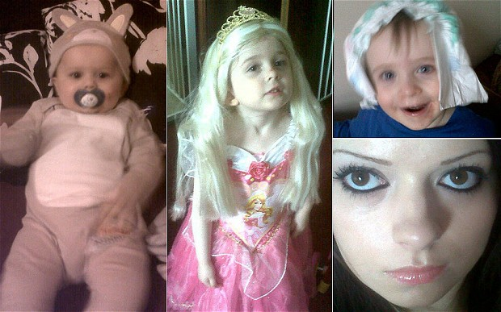
Anderson family - All 3 children died in April 2013
http://suffolksafeguardingchildrenboard.onesuffolk.net/news/suffolk-lscb-serious-case-review-report/
The family were known to Suffolk County Council who started working with them prior to the birth of the eldest child due to concerns about parenting ability. The children were all known to the multi-agency network from then until the time of their death. Mother was difficult to engage with and there were numerous child protection plans but very little progress was made in improving the care of the children. There were concerns of neglect and emotional harm and the state of mother’s mental health.
Learning
Importance of:
• Using innovative multi-agency interventions and initiatives when there is a difficulty in engaging parents
• Assessment of emotional abuse and neglect on children
• Challenging drift in cases and the responsibility of all professionals to challenge inappropriate or ineffectual practice
• Looking at parents history when assessing parenting
capacity
• Effective use of legal interventions

Slide 12
Learning from case reviews involving parental substance misuse- NSPCC 2013 Introduction
Parental substance misuse is widely recognised as one of the factors that puts children more at risk of harm. In these case reviews, children died, or were seriously injured in a number of different ways:
•sudden infant death syndrome associated with co-sleeping
•accidental ingestion of drugs
•accidents (fire, drowning) due to inadequate adult supervision
•parents deliberately giving children drugs.
The biggest risk posed to children is that parents, when under the influence of drugs or alcohol, are unable to keep their child safe (i.e. overlay and accidents caused through lack of supervision).

Slide 13
Assessments
There is a clear message about the importance of timely and thorough assessments with regards to all the children cared for by substance misusers. The assessments need to be child-focused. They should present a clear picture of the user’s drug and alcohol consumption, and carers’ usage and behaviour must be properly analysed to understand the risks that this poses to the children. This should include an assessment of parenting capacity.
Where other risk factors are also present (parental mental ill health, domestic violence), the relationship between these factors and a parent’s substance misuse should be taken into account.
Risk assessments should be a dynamic rather than a static (one-off) process, which are reviewed in the light of emerging evidence.

Slide 14
Rule of optimism
Professionals too often trusted the parents’ self-reporting of their drug and alcohol consumption. Their substance misuse was known about but not seen as excessive or problematic. Some reviews talk about tidy and clean homes and happy and healthy children.

Slide 15
Communicating with parents
It is important that information is delivered in such a way that parents are able to understand it. Professionals should regularly check that parents have understood the risks and are complying with the advice. Written leaflets are not suitable for functionally illiterate adults.
Some parents said they did not feel that the risks of co-sleeping had been explained in such a way that they had fully understood them, or had taken them on board.

Slide 16
Interventions
Work with adults often focused on their individual needs rather than their role as parents.

Slide 17
From Child K:
Recommendation 2:
For all Agencies to develop a culture of challenge and curiosity as part of the process of information gathering. This includes:
• Proactively investigating the child's wider circumstances where concerns have been raised, particularly when a male partner joins the family and refuses to engage with/avoids professionals and has a negative impact on family dynamics
• Good practice around challenging families where there is cause to suspect lying, keeping secrets, and/or avoidance can be evidenced within assessments and recorded on the child's records.
• Challenge and curiosity should also be demonstrated to workers by their line managers and recorded in supervision records.
Where there are gaps in knowledge about a child's home circumstances, there should be evidence of how workers have tried to address the gaps by talking to partners working with the child or family

Slide 18
The struggle not to be overwhelmed
‘Do the simple things well’ (Laming) - but acknowledge that child protection is not simple
The capacity to understand the ways in which children are at risk of harm requires clear thinking
Practitioners who are overwhelmed, not just with the volume of work but by the nature of the work, may not be able to do even the simple things well
Child protection spreads across all levels of intervention (Climbié Report)
“child protection does not come labelled as such”

Slide 19
Promoting positive practice
All practitioners (at all levels) need to be aware of risks of significant harm, and have up-to date child protection training, particularly if there are unqualified staff, and poor family co-operation
All agencies need a holistic understanding that incorporates inter-acting risk factors
“..ultimately the safety of a child depends on staff having the time, knowledge and skill to understand the child or young person and their family circumstances.” (Lord Laming 2009:10)
Wise to avoid knee jerk reactions and make hasty policy on the basis of single disastrous cases

Slide 20
Promoting positive practice
No public outrage on behalf of vulnerable adolescents who feature repeatedly in serious case reviews and carry the legacy of maltreatment and rejection with them. Their needs and distress have often been missed, have been too challenging, or expensive for services to meet
Need for accessible CAMHS and outreach services for children at lower levels of intervention
Need for services to address trauma, rejection and long term abuse
Need for services at age 16/17 and leaving care
Need for good quality supervision – culture of support and reflective practice. Practitioners need time and permission to discuss

Slide 21
Challenge
Lord Laming’s phrase ‘respectful uncertainty’ in professionals assessment & work with families
There needs to be respectful challenging of one’s own colleagues
Likewise challenging professionals in other agencies and organisations
It is every professionals’ responsibility to say “No, I disagree”.
Wherever they sit in the hierarchy, at the end of the day they are just a person. And at the end of the day it is about the child.

Slide 22
It’s not easy
There are no simple or easy answers to the challenge of protecting children, only a relentless focus on doing the best we possibly can, at every level and in every service.
But Laming’s full and frank analysis does not provide a guarantee against the combination of failings and circumstances that led to the death of Baby P.
The unpredictability of human nature and the restrictions on the current system mean the scale of the task is immense.
(Eaton, Bromley-Derry, Myers Guardian Letters, April 15 2009)

